Slide 1
Big Data and Bias
Notes:
In this video, we’ll learn what is meant by big data and the potential biases that can be found with using it.

Slide 2
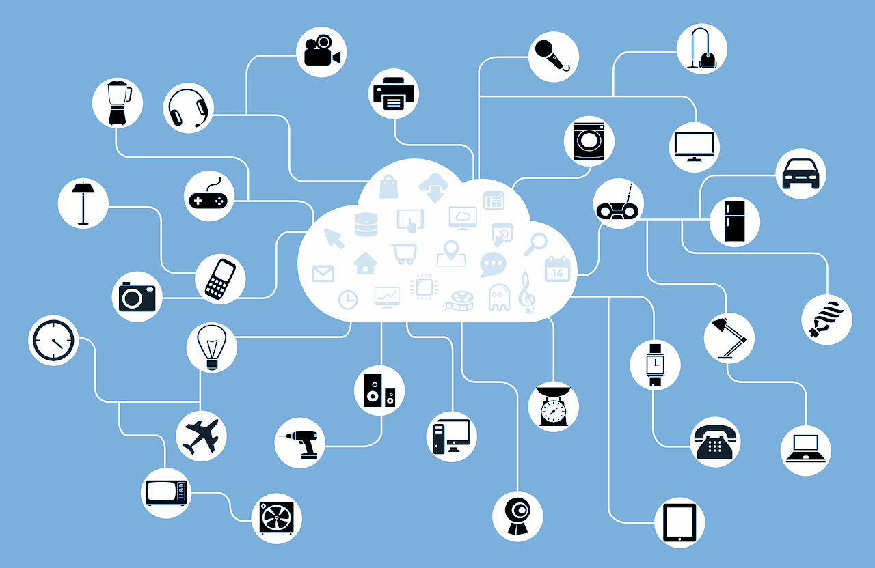
Big Data
Big data refers to data that is so large, fast or complex that it's difficult or impossible to process using traditional methods.
Notes:
Big Data is basically exactly what it sounds like.. it’s a lot of data! Big data differs from just normal data because it’s generated at such a fast rate that it’s difficult to maintain and use. Big data often requires a lot of effort to make sure the data is ready to use and interpret.

Slide 3
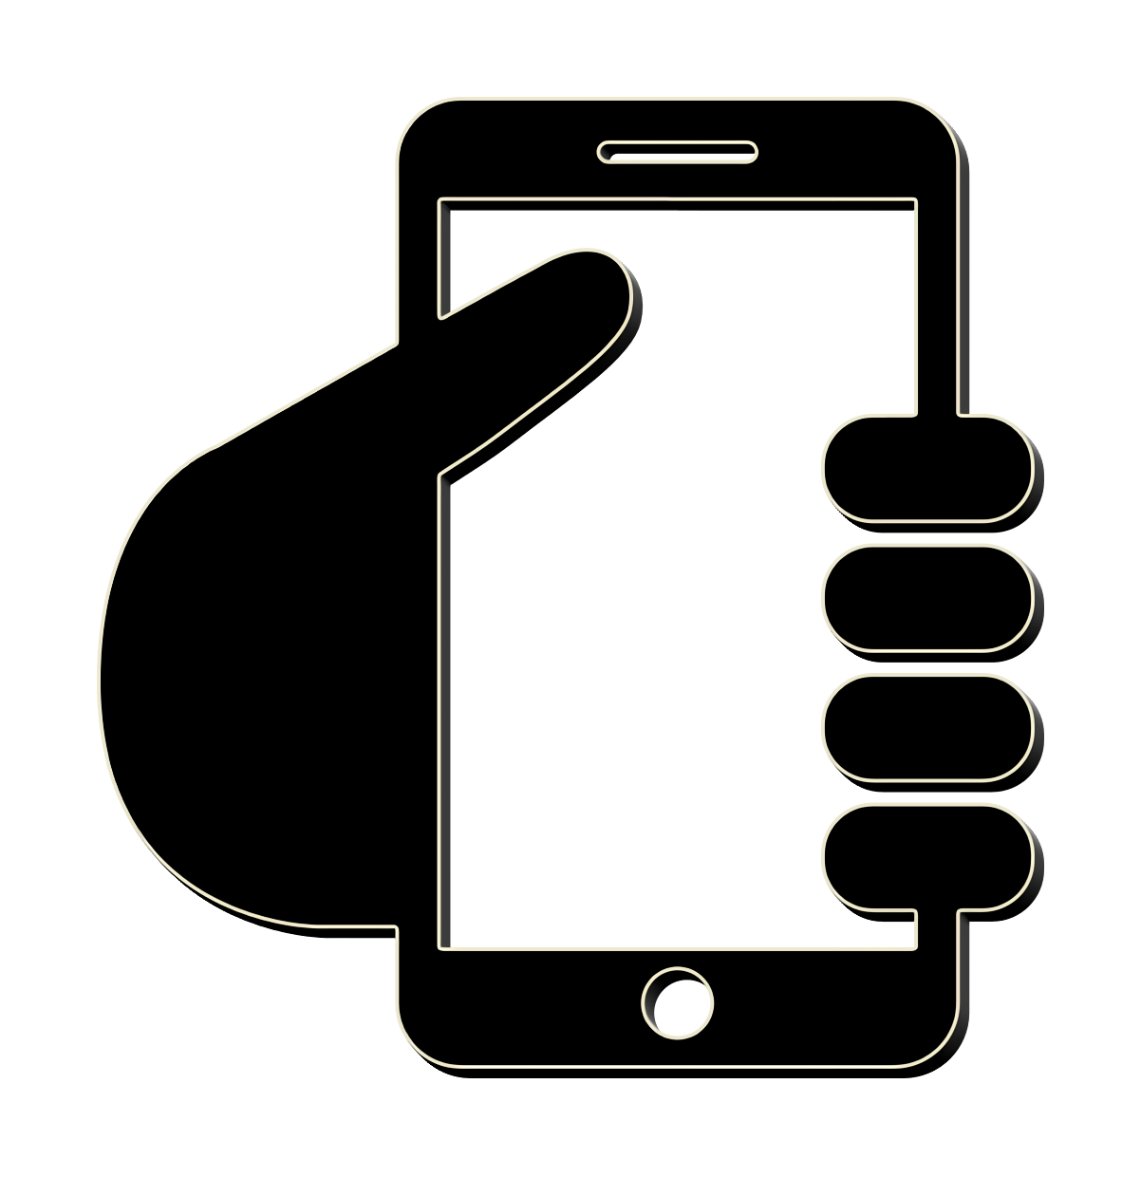
Big Data
ok
okay
k
kay
👍
Notes:
Big Data is basically exactly what it sounds like.. it’s a lot of data! Big data differs from just normal data because it’s generated at such a fast rate that it’s difficult to maintain and use. Big data often requires a lot of effort to make sure the data is ready to use and interpret. Think about how you might text your friend a simple phrase like “ok”. You might text “okay”, “ok”, “k”, “kay”, and many more! We could also use uppercase or lowercase letters, emojis as well. All of these possible choices creates data. This data needs to be prepared if we want to use this to, let’s say, train a computer to recognize that all of these words all mean the same thing.

Slide 4
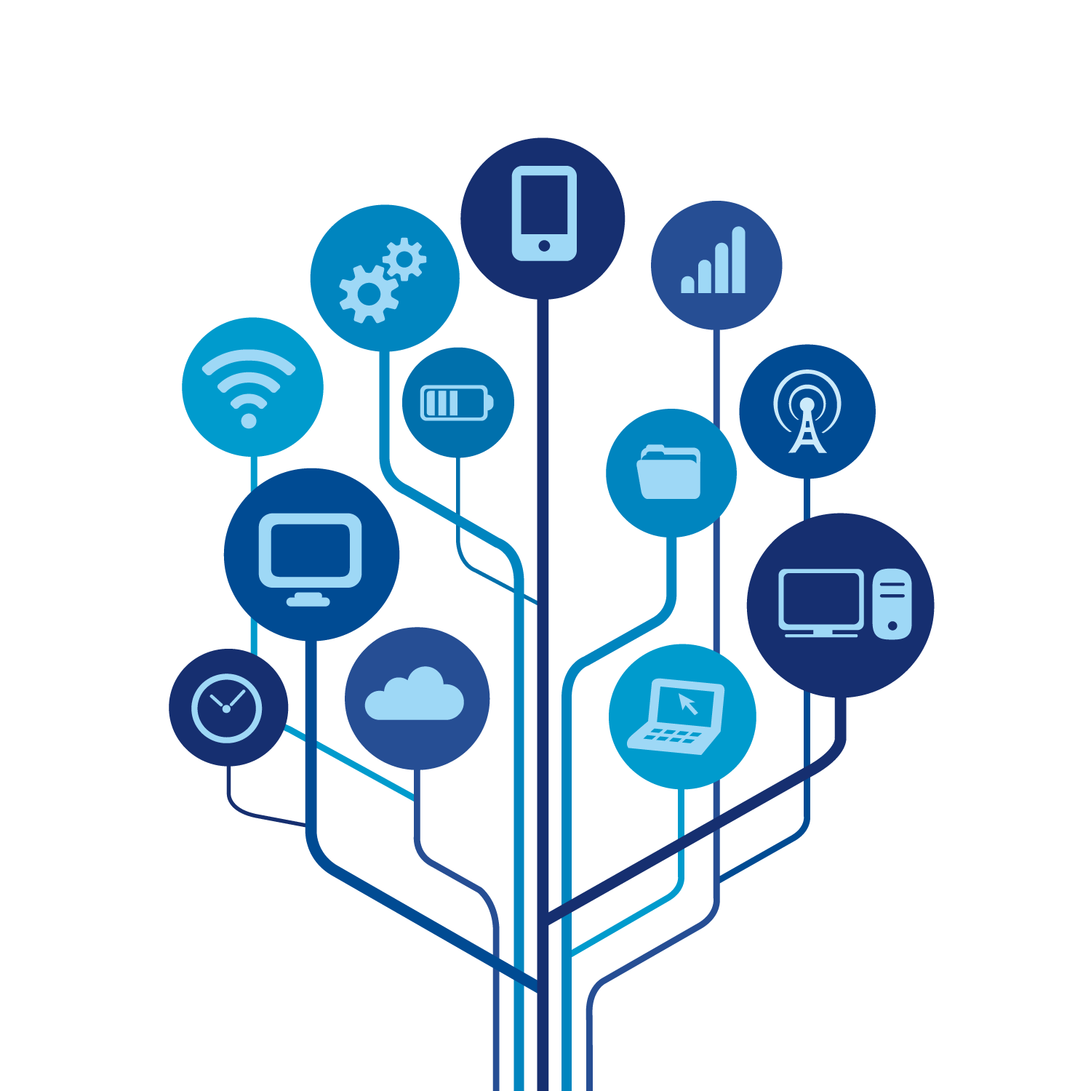
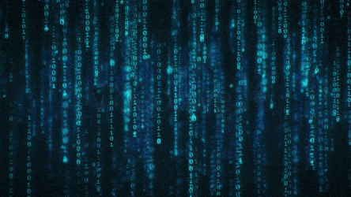
Big Data
Notes:
So, how much data is there really? With the increasing number of people and cities connected to the Internet, data sets are growing fast. Most of the data available today was only collected in the last couple of years. This is mainly due to the rise in smartphones, tablets and connected devices. There are so many connected devices in today’s world that are all collecting data. The crazy part is that most of this data is sitting in storage and unused -- just waiting to be analyzed by data scientists! An advantage of storing and using datasets this large is that they offer new opportunities that were impossible with a smaller data set.

Slide 5

Big Data
Health Records
App Interactions
Location Data
Notes:
There are also some ethical concerns and potential disadvantages of big data. Much of the data in these large data sets is related to people in some ways. Data could be collected from your health records, how you use your favorite apps and even your location data. Whenever any organization is storing and processing massive data sets that either represent or affect humans, they must be extremely careful. If the data contains personal information, permission must be given and the data must be carefully secured using some type of encryption.
Another important ethical concern is the presence of bias.

Slide 6
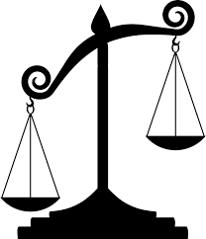
Bias in Data
Bias in data occurs when a result is more favorable to a certain outcome.
Data Collection
Data Analysis
Data Visualizations
Notes:
Bias in data occurs when a result is more favorable to a certain outcome. This can happen for a variety of reasons. There can be bias in the way that data is collected, the way it’s analyzed and the way it’s shown in a visualization. In this lesson, we’ll mostly focus on bias in data collection but we’ll revisit the topic a few times in future lessons. Bias in data collection can happen if the information gathered does not accurately represent the population as a whole. Let’s say you are running a survey at your school. If you only ask the first 20 people you see, your data might not reflect the whole diverse population of your school. What if the first 20 people you saw were all males - or all 10th graders?
It’s important to have diversity in the population you survey. It’s also very important to have diversity in the team who is conducting the data analysis as well.

Slide 7

Bias in Data
Machine learning is a branch of artificial intelligence focused on building applications that learn from data.
Notes:
Let’s talk about machine learning just a bit to understand bias further. Machine learning is a branch of artificial intelligence focused on building applications that learn from data. These programs can be trained using data and are able to learn and improve on their own! A very important factor in reducing bias deals with the selection of training data used to build these programs.

Slide 8
Bias in Data
Machine learning is a branch of artificial intelligence focused on building applications that learn from data.
Group B
Group A
Notes:
If the program is trained using datasets that contain very few examples of a particular demographic group, it could be worse at accurately recognizing or learning about members of that group.

Slide 9
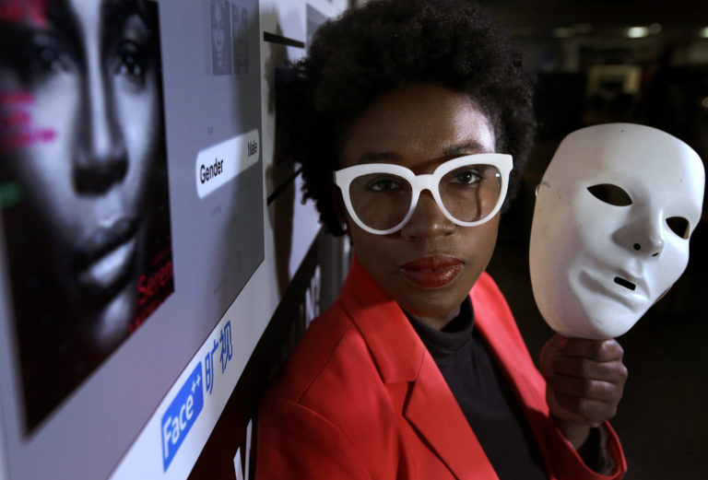
Bias in Data
Joy Buolamwini
Computer Scientist
Algorithmic Justice League Founder
Source: https://www.insurancejournal.com/news/national/2019/04/08/523153.htm
Notes:
An example of a biased program due to under representation in data was brought forward by Joy Buolamwini. Joy is a computer scientist and the founder of the Algorithmic Justice League whose mission is to ensure that artificial intelligence is equitable and held accountable.
Joy’s motivation for founding this company started when she attempted to use a facial recognition program. The program would not recognize her face, until she put on a white mask. Then the program worked.
Not only are certain groups undersampled in the data that train these programs but the same groups are less likely to be involved in the development of the program as well. An emphasis needs to be placed on creating more diversity in tech companies by including more women and more people of color.

Slide 10
Bias in Data
Which question is unbiased?
a. Does the school board have the right to enforce a dress code? b. Do you think the mayor is doing a good job in spite of his questionable character? c. Do you prefer daytime or evening television programming? d. Do you think the government should be allowed to cut down trees willy-nilly to build a new highway?
Notes:
Bias can be found in all aspects of the data science life cycle. For now, within your projects, you’ll want to focus on possible bias that can be found within a statistical question and in the data collection phase. Pause the video and read these four questions. All of them except one contains an element of bias. Can you figure out which question is the unbiased question?

Slide 11
Bias in Data
Which question is unbiased?
a. Does the school board have the right to enforce a dress code? b. Do you think the mayor is doing a good job in spite of his questionable character? c. Do you prefer daytime or evening television programming? d. Do you think the government should be allowed to cut down trees willy-nilly to build a new highway?
Notes:
Did you get it? This is the only question that doesn’t lead towards one answer over the other. All of the other questions include words or phrases that show that one answer is favored over the other. You could even make an argument for choice C including some bias since the question is forcing a choice of either daytime or evening television. What if a person doesn’t like either? Or doesn’t watch TV?

Slide 12
Bias in Data
Which question is biased?
a. Do you prefer daytime or evening television programing?
b. Should there be a school dress code?
c. Do you prefer news or mindless sitcoms?
d. Do you think a new highway should be built?
Notes:
Sometimes it’s harder to notice. Pause the video again. This time there is only one question that IS biased. Can you find it?

Slide 13
Bias in Data
Which question is biased?
a. Do you prefer daytime or evening television programing?
b. Should there be a school dress code?
c. Do you prefer news or mindless sitcoms?
d. Do you think a new highway should be built?
Notes:
The word “mindless” leads people to think that sitcoms is the incorrect choice. The person asking this question is biased towards watching news over sitcoms.

Slide 14

Confirmation Bias
Confirmation bias is the tendency to seek out, collect and interpret data so that it confirms one’s preexisting beliefs or ideas.
Ways to Avoid Confirmation Bias:
Be aware of your own bias!
Use data to discover rather than confirm.
Be sure to seek out evidence that could possibly disprove your hypothesis.
Ask a friend to review your data and propose possible arguments against it.
Notes:
Another type of bias to watch out for is confirmation bias and can occur in the data collection phase of statistical research. Confirmation bias is when you search for and use only data or information that agrees with, or confirms, what you think the answer or outcome should be. The vastness of the Internet can be a tool but also a crutch. You will always be able to find articles and data analysis that supports both sides of an argument. A few strategies that can be used to avoid confirmation bias is to first and foremost - just be aware of your own bias! What you are hoping the study shows? You should also go into the study with the goal of using data to discover, rather than to confirm. You may get through the whole study, make a few discoveries but still not fully answer your hypothesis or question. Be sure to be intentional in searching for data or evidence that could possibly disprove your hypothesis. And lastly, ask a friend to review what you have and come up with some arguments to challenge your position.

Slide 15
Lesson Vocabulary
Term | Definition
big data | Refers to data that is so large, fast or complex that it's difficult or impossible to process using traditional methods.
bias | Occurs when a result is more favorable to a certain outcome.
machine learning | A branch of artificial intelligence focused on building applications that learn from data.
confirmation bias | The tendency to seek out, collect and interpret data so that it confirms one’s preexisting beliefs or ideas.

Slide 16
Questions

Slide 17
In which phase of the data science life cycle would a researcher be most concerned with the possibility of confirmation bias?
Notes:
🍐 This is a Pear Deck Multiple Choice Slide. Your current options are: A: Ask Questions, B: Consider Data, C: Analyze Data, D: Interpret Data,
🍐 To edit the type of question or choices, go back to the "Ask Students a Question" in the Pear Deck sidebar.

Slide 18
Which question is unbiased?
Notes:
🍐 This is a Pear Deck Multiple Choice Slide. Your current options are: A: Why is it best for a dress code to exist?, B: Would you prefer to eat a delicious steak or a plain sandwich?, C: How many hours do you typically sleep per night?, D: Should concerned dog owners vaccinate their pets?,
🍐 To edit the type of question or choices, go back to the "Ask Students a Question" in the Pear Deck sidebar.

Slide 19
You are asked to rephrase the following question so that it is not biased:
Where do you like to party on the weekends?
Which would be the best replacement for this question?
Notes:
🍐 This is a Pear Deck Multiple Choice Slide. Your current options are: A: It is not biased as is., B: Do you like to party or stay home on the weekends?, C: When you party on the weekends, where do you like to go?, D: What do you like to do on the weekends?,
🍐 To edit the type of question or choices, go back to the "Ask Students a Question" in the Pear Deck sidebar.

